Slide 1




G.H. RAISONI COLLEGE OF ENGINEERING
AND MANAGEMENT, WAGHOLI, PUNE.
Department of AI & AIML
Attendance System using Face Recognition
Guide:
Prof. Nutan Raut Mam
Name of Projectees
Mitesh Agrawal _ 28 Sandeep Reddy_ 30
Ritika Nagve_ 31 Dhananjay Nerkar_ 33

Slide 2
Contents
Introduction
Justifications for Selecting the Title
Problem Statement
Literature Survey
Block Diagram
Expected Result
Work plan
References

Slide 3
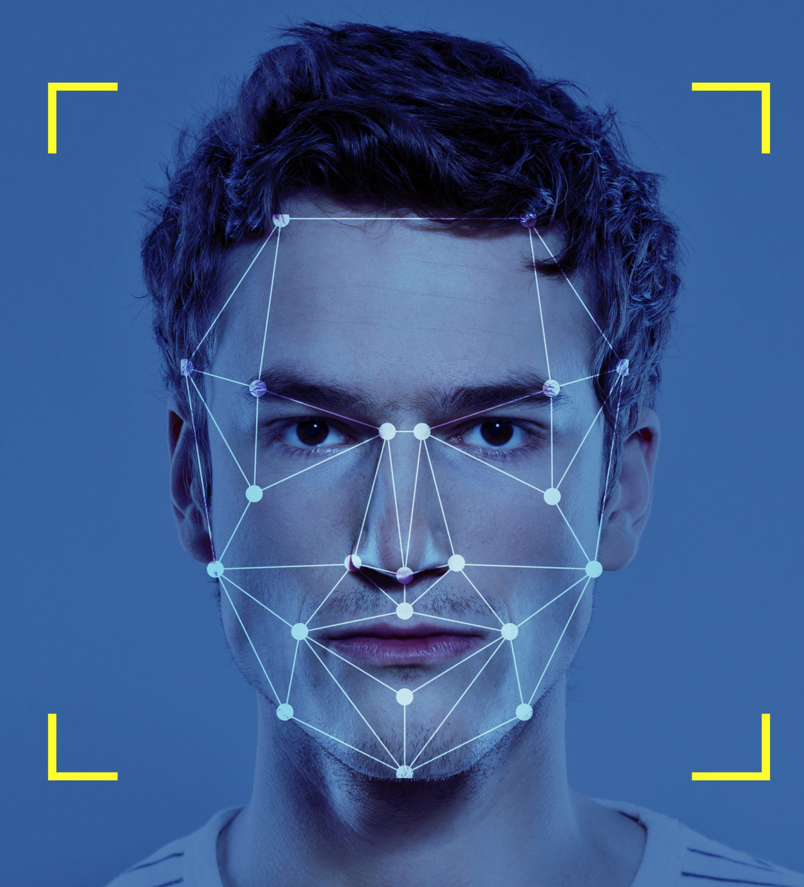
Introduction
INTRODUCTION / BACKGROUND ABOUT THE PROJECT:-
This project aims to develop a real-time face recognition system that seamlessly integrates with a database, enabling efficient and accurate identification of individuals in dynamic environments. This technique can be extensively utilized because it is a contactless and non-invasive technique.
Attendance system using face recognition is a procedure of recognizing students by using face biostatistics using some computer technologies and webcams.
The development of this system is aimed to accomplish digitization of the traditional system of taking attendance by calling names and maintaining pen-paper records. This technique can be used in Schools , Colleges , Companies , Hospitals , Offices.

Slide 4
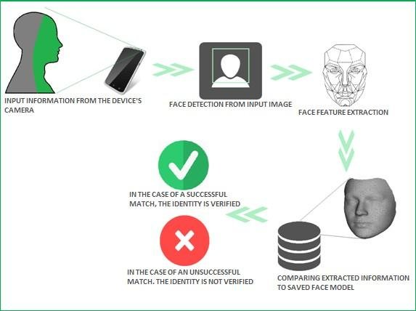
Introduction
INTRODUCTION / BACKGROUND ABOUT THE PROJECT:-
The traditional way of marking commute to work can be tedious task in many skills and colleges. It is also an additional responsibility for schools to mark an attendance by naming Individuals which may take up to 5 to 10 minutes for a full session.
This system consists of four phases:-
1. Accessing WebCam
2. Face Detection
3. Face Recognition
4. Attendance Updation
Database is created by using the Images, Roll_No and Name, Last time when attendance was marked, subject total attendance.

Slide 5
Justification For Selecting The Title
JUSTIFICATION OF TITLE WITH PROJECT:-
The inclusion of "Face Recognition" in the title emphasizes the innovative technology used in the system. It signifies that the system leverages advanced facial recognition technique used for attendance management.
The title does not limit the system to a specific context, making it suitable for a wide range of applications.
It leaves no ambiguity about the system's intended function, making it easy for users and stakeholders to understand its core objective.
The title conveys the idea that the system is designed for streamline attendance tracking, saving time and effort of both administrators and attendees.
The title suggests that the system is likely designed with user convenience in mind, potentially boosting its appeal to a wide range of users.

Slide 6
Problem Statement
PROBLEM IDENTIFIED AND ITS JUSTIFICATION:-
Spoofing multiple attendance by same person:-
In schools and colleges, students has a tendency of marking their friend’s attendance who were not present for the respective lecture. For overcoming this problem we will make use of this system where we will marks attendance of students by recognizing their facial expressions.
In our system students can’t spoof other’s attendance as we are making use of face-recognition libraries that will allow us to sense student’s eyes, by using this feature we will mark attendance efficiently , here we will make use of high quality cameras to do the same.
This model will be installed in every faculty’s Laptop/PC and the camera access will be given by them through their phone and the attendance will be updated in database.

Slide 7
Literature Survey
Sr. No. | Paper Title and its Author | Details of Publication | Findings
1 | International Journal of Engineering Research & Technology (IJERT) (Pavithra S Hegde) | ISSN: 2278-0181 IJERTV9IS050861 Published by : www.ijert.org Vol. 9 Issue 05, May-2020 | This documentation helped us to know about basic details about the algorithms that were used in the project. From this we came to know in detail about libraries of OpenCV.

Slide 8
Block Diagram
BLOCK DIAGRAM OF VARIOUS STAGES OF PROJECT:-
Access Webcam
Loading Graphics
Encoding Generator
Face Detection
Update Database
Verification of candidate
Database
Face Recognition
(Local Binary Pattern Histogram)

Slide 9
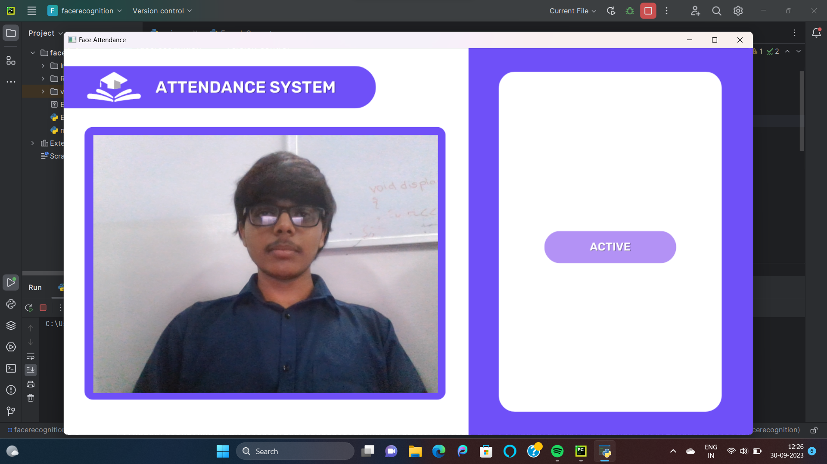
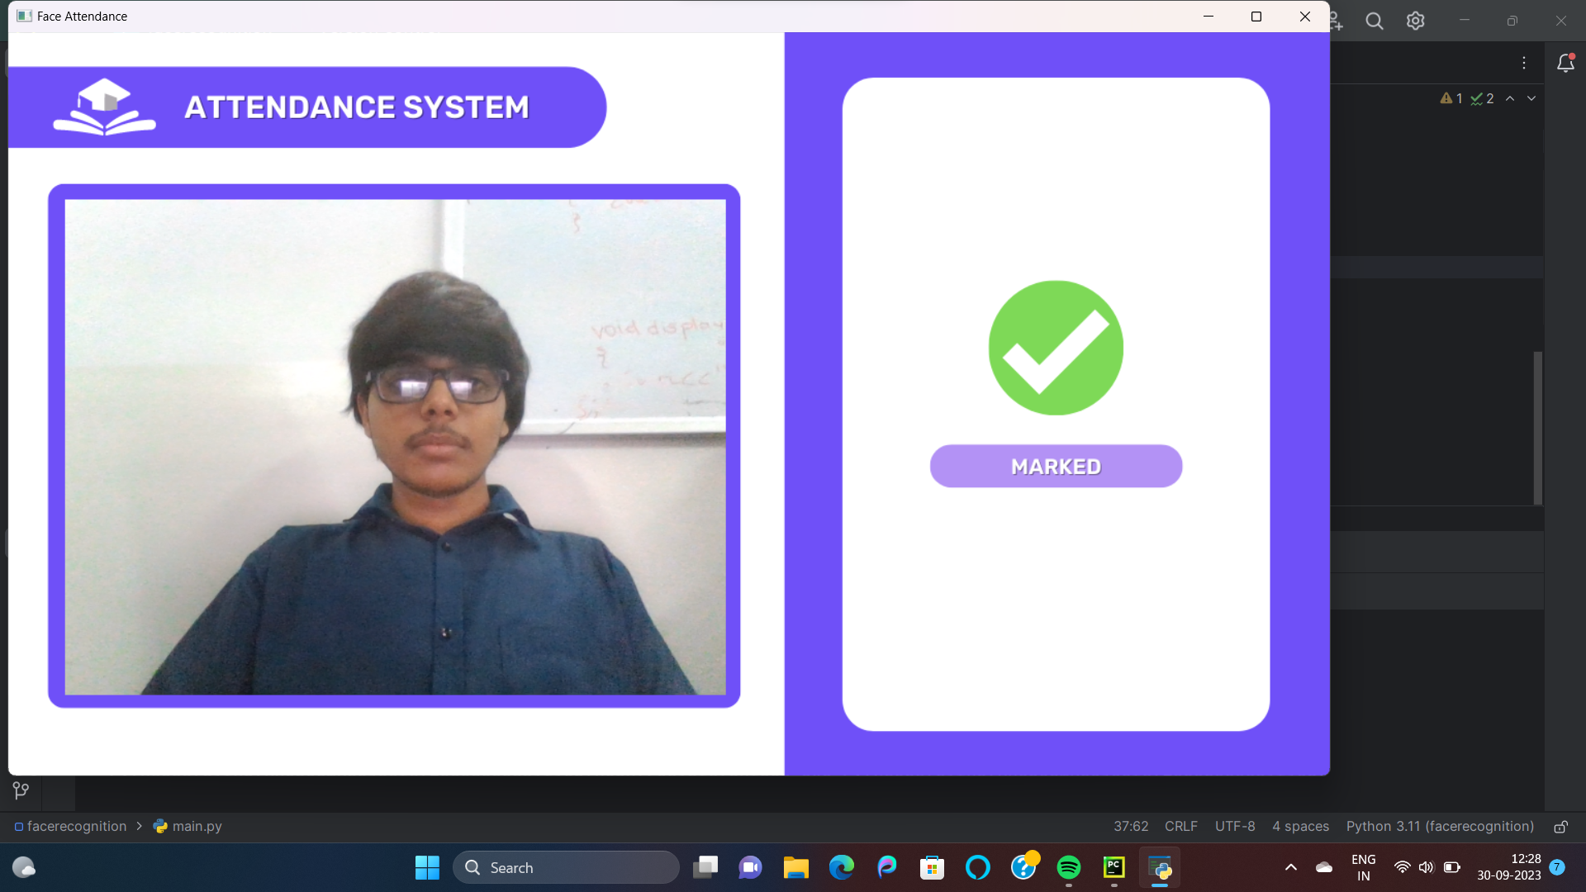
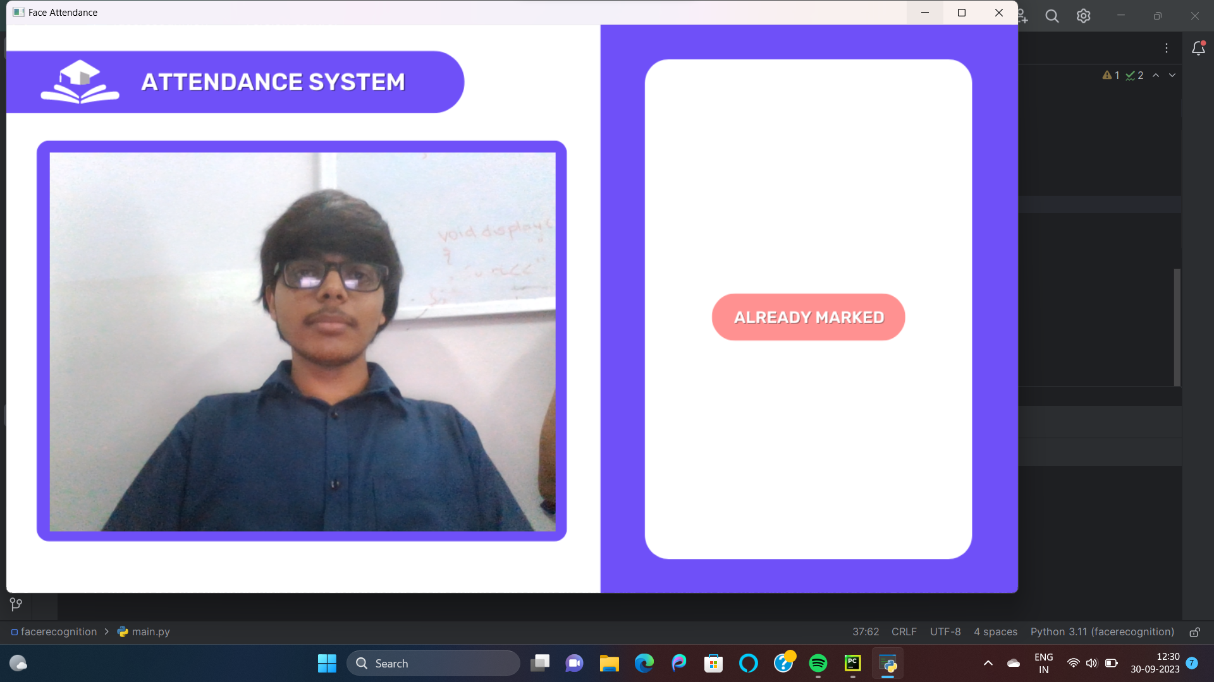
Expected Result
This intervace will occur at user’s end , this will show when the attendance is marked and will simultaneously update the database.
Once attendance is marked it will show as already marked.

Slide 10
Work – Plan
Months Activities | August’23 | Sept’23 | Oct’23 | Nov’23
Literature Reviews | √
Requirement Analysis | √
Designing | √
Experimental Analysis | √ | √ | √
Module wise Implementation |  | √ | √
Testing and Debugging |  |  | √ | √
Preparation of Project Report |  |  |  | √

Slide 11
References
LIST OF PAPERS/BOOKS/WEBSITES ETC REFERED FOR PROJECT:-
https://www.computervision.zone/courses/face-recognition-with-real-time-database/
International Journal of Engineering Research & Technology (IJERT)
ISSN: 2278-0181
Published by : www.ijert.org
Vol. 9 Issue 05, May-2020

Slide 12
Thank you !

